Slide 1
Elasticity of Demand and Supply

Slide 2
Elasticity of Demand and Supply
Elasticity
When studying how some event or policy affects a market, we can discuss not only the direction of the effects but their magnitude as well.
Elasticity is a measure of how much buyers and sellers respond to changes in market conditions.
Elasticity is a measure of the responsiveness of quantity demanded or quantity supplied to changes of one of its determinants.

Slide 3
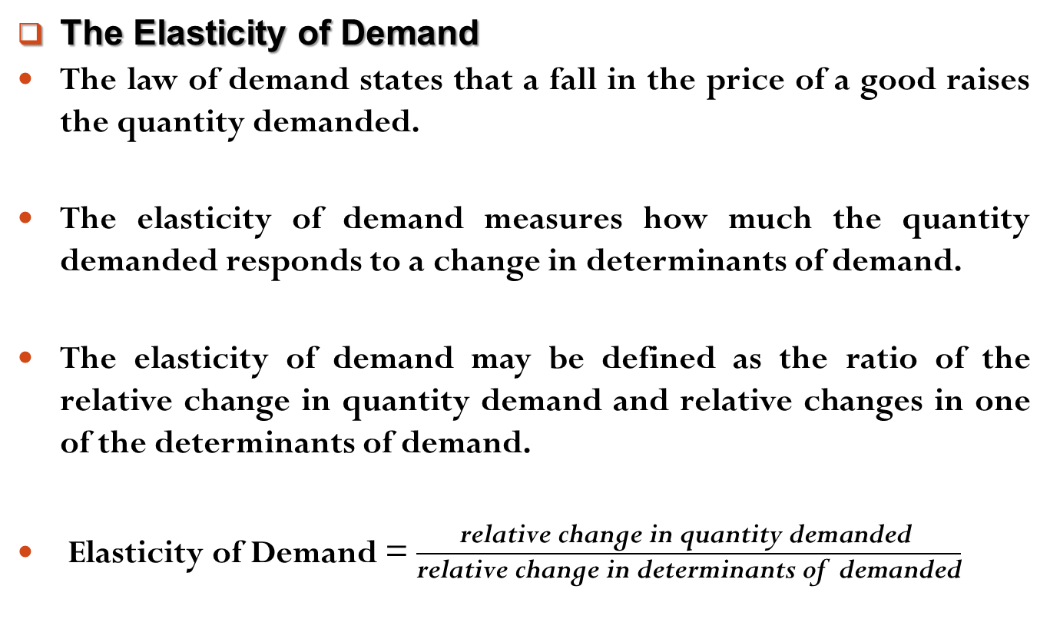
Elasticity of Demand and Supply
The Elasticity of Demand
The law of demand states that a fall in the price of a good raises the quantity demanded.
The elasticity of demand measures how much the quantity demanded responds to a change in determinants of demand.
The elasticity of demand may be defined as the ratio of the relative change in quantity demand and relative changes in one of the determinants of demand.
Elasticity of Demand = $\frac{\text{relative} \text{change} \text{in} \text{quantity} \text{demanded} }{\text{relative} \text{change} \text{in} \text{determinants} \text{of} \text{demanded}}$

Slide 4
Elasticity of Demand and Supply
The Elasticity of Demand
There are three kinds of elasticity of demand. They are,
Price Elasticity of Demand
Income Elasticity of Demand
Cross Price Elasticity of Demand

Slide 5
Elasticity of Demand and Supply
The Price Elasticity of Demand
The Price elasticity demand may be defined as the ratio of the relative change (or percentage change) in quantity demand to the relative change (or percentage change) in price.
To measure price elasticity demand we have two formula,
Point Elasticity of demand Method
Arc Elasticity of demand Method

Slide 6
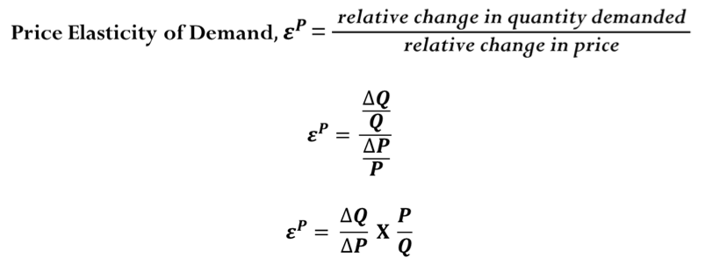
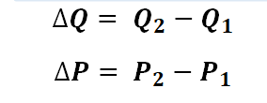
Elasticity of Demand and Supply
The Price Elasticity of Demand
Point Elasticity of demand Method
Point elasticity of demand takes the elasticity of demand at a particular point on a curve (or between two points).
Where,

Slide 7
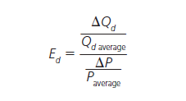
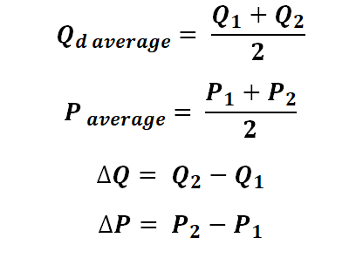
Elasticity of Demand and Supply
The Price Elasticity of Demand
Arc Elasticity of demand Method
Arc elasticity measures elasticity at the midpoint between the two selected points:
Where,

Slide 8
Elasticity of Demand and Supply
The Price Elasticity of Demand
There are five types of price elasticity of demand. They are,
Relatively Elastic Demand
Relatively Inelastic Demand
Unitary Elastic Demand
Perfectly Elastic Demand
Perfectly Inelastic Demand

Slide 9
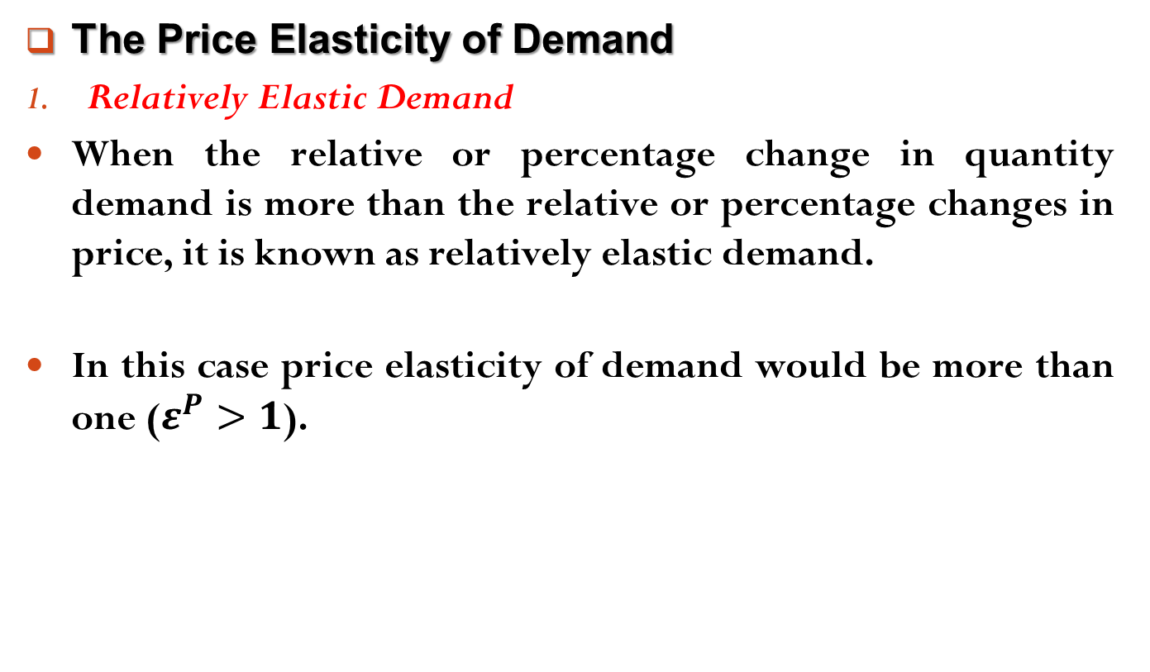
Elasticity of Demand and Supply
The Price Elasticity of Demand
Relatively Elastic Demand
When the relative or percentage change in quantity demand is more than the relative or percentage changes in price, it is known as relatively elastic demand.
In this case price elasticity of demand would be more than one ($ε^{P}>1$).

Slide 10
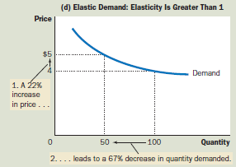
Elasticity of Demand and Supply
The Price Elasticity of Demand
Relatively Elastic Demand

Slide 11
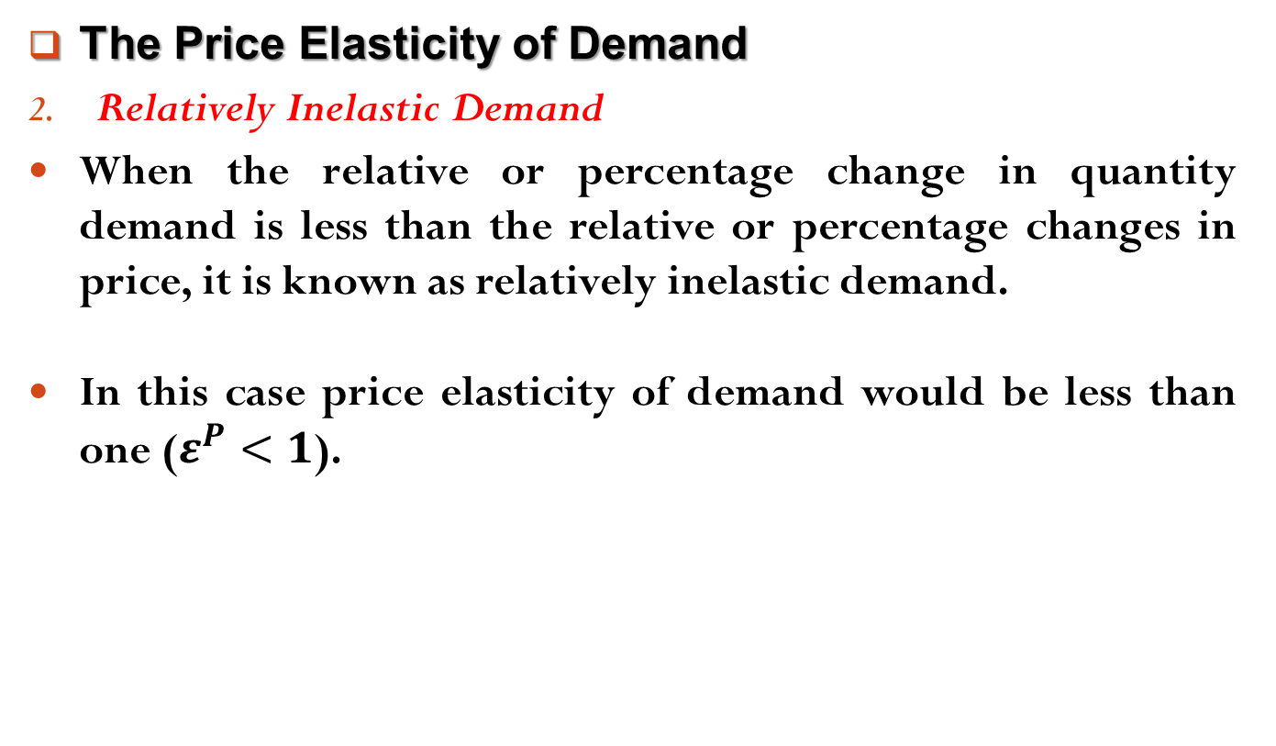
Elasticity of Demand and Supply
The Price Elasticity of Demand
Relatively Inelastic Demand
When the relative or percentage change in quantity demand is less than the relative or percentage changes in price, it is known as relatively inelastic demand.
In this case price elasticity of demand would be less than one ($ε^{P}<1$).

Slide 12
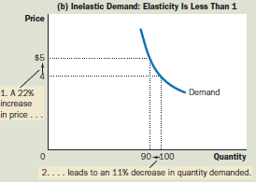
Elasticity of Demand and Supply
The Price Elasticity of Demand
Relatively Inelastic Demand

Slide 13
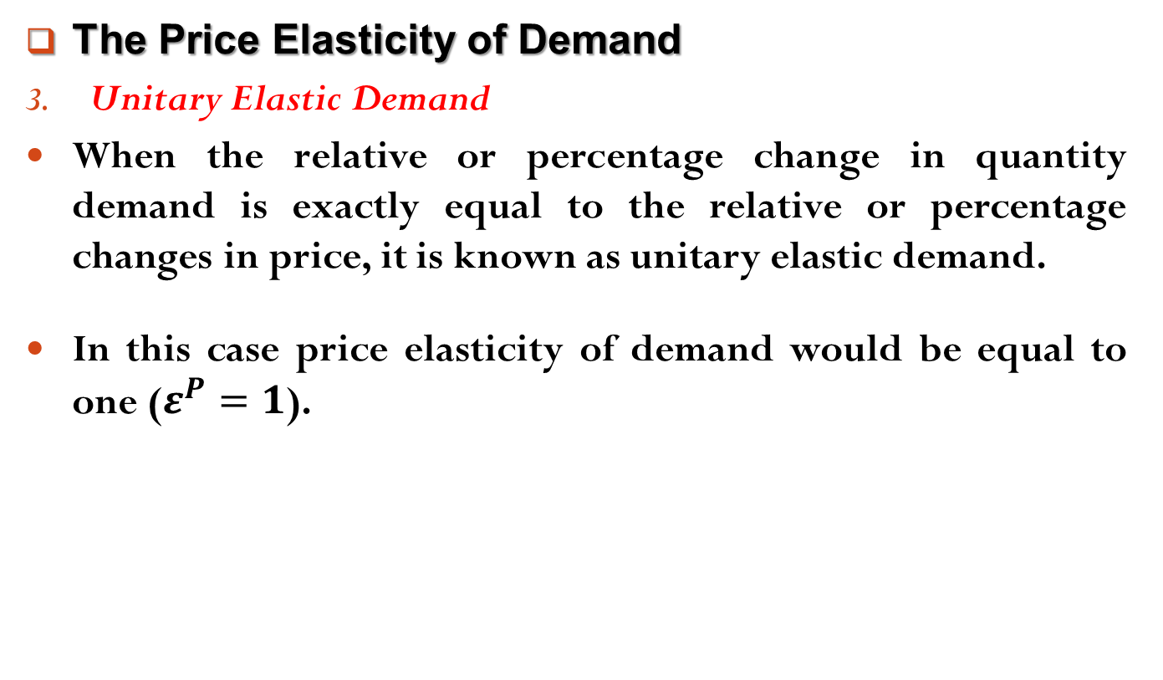
Elasticity of Demand and Supply
The Price Elasticity of Demand
Unitary Elastic Demand
When the relative or percentage change in quantity demand is exactly equal to the relative or percentage changes in price, it is known as unitary elastic demand.
In this case price elasticity of demand would be equal to one ($ε^{P}=1$).

Slide 14
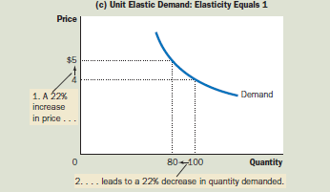
Elasticity of Demand and Supply
The Price Elasticity of Demand
Unitary Elastic Demand

Slide 15
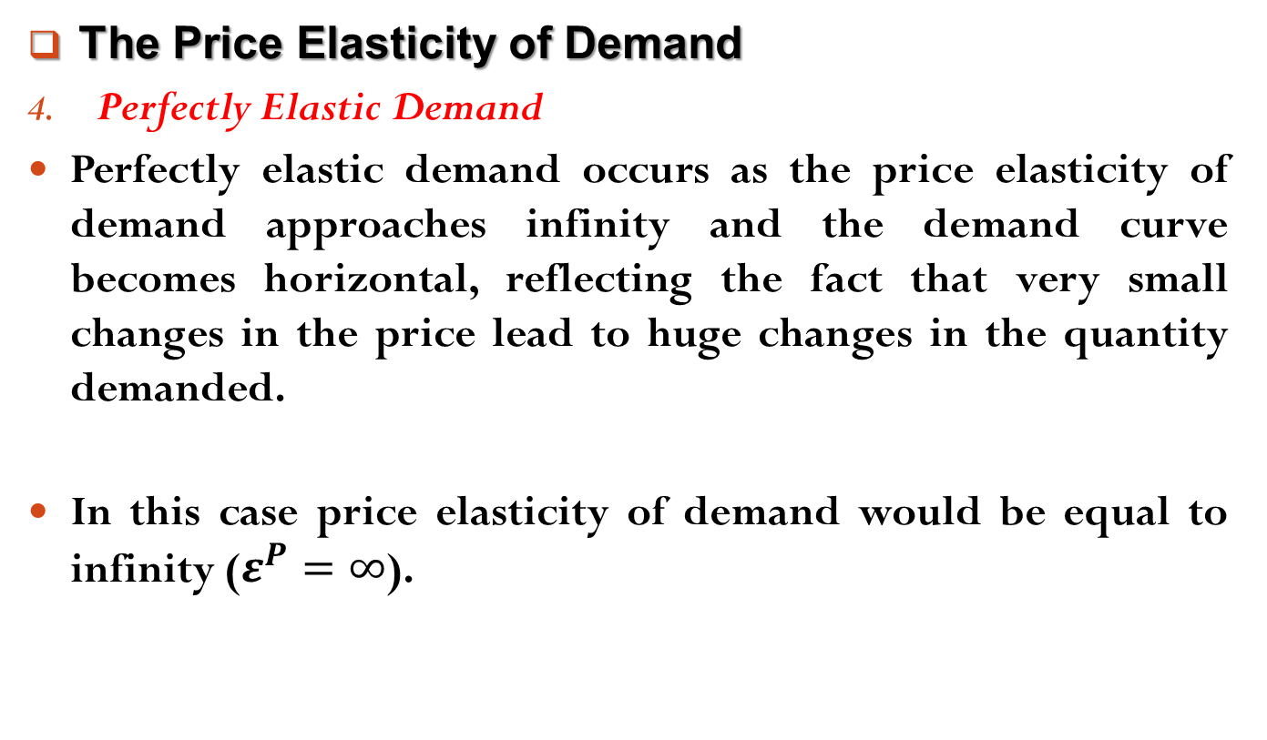
Elasticity of Demand and Supply
The Price Elasticity of Demand
Perfectly Elastic Demand
Perfectly elastic demand occurs as the price elasticity of demand approaches infinity and the demand curve becomes horizontal, reflecting the fact that very small changes in the price lead to huge changes in the quantity demanded.
In this case price elasticity of demand would be equal to infinity ($ε^{P}=∞$).

Slide 16
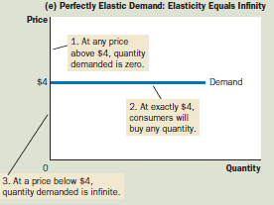
Elasticity of Demand and Supply
The Price Elasticity of Demand
Perfectly Elastic Demand

Slide 17
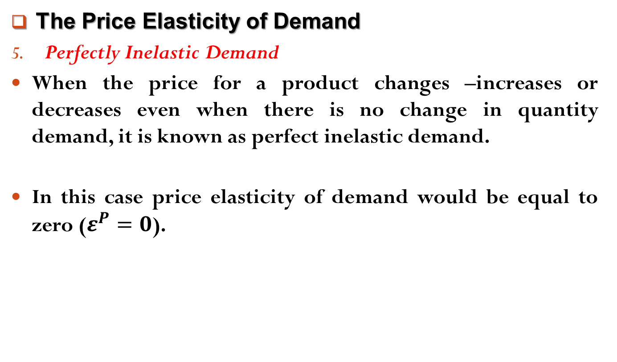
Elasticity of Demand and Supply
The Price Elasticity of Demand
Perfectly Inelastic Demand
When the price for a product changes –increases or decreases even when there is no change in quantity demand, it is known as perfect inelastic demand.
In this case price elasticity of demand would be equal to zero ($ε^{P}=0$).

Slide 18
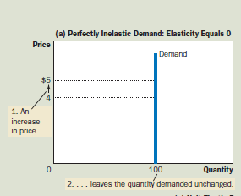
Elasticity of Demand and Supply
The Price Elasticity of Demand
Perfectly Inelastic Demand

Slide 19
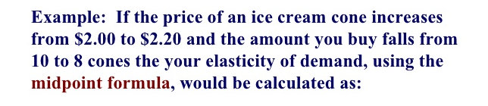
Elasticity of Demand and Supply
The Price Elasticity of Demand
Find the price elasticity of demand when,
Price Per Unit | Quantity
10 | 0
9 | 10

Slide 20
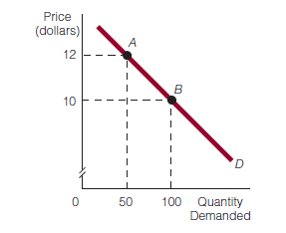

Elasticity of Demand and Supply
Elasticity Is Not Slope
Some tend to think that slope and price elasticity of demand are the same, but they are not.
Suppose we have a demand curve in Exhibit 1.

Slide 21
Elasticity of Demand and Supply
Elasticity Is Not Slope
To calculate the price elasticity of demand between points A and B, we divide the percentage change in quantity demanded (between the two points) by the percentage change in price (between the two points).
Using the price elasticity of demand formula, we get 3.67.
The slope of the demand curve between points A and B is the ratio of the change in the variable on the vertical axis to the change in the variable on the horizontal axis.

Slide 22

Elasticity of Demand and Supply
Elasticity Is Not Slope
The slope of the demand curve reflects the change, not a percentage change.
Then find the price elasticity demand and slope between points B and C.
8
C
150

Slide 23
Elasticity of Demand and Supply
Determinants of the Price Elasticity of Demand
The price elasticity of demand for any good measures how willing consumers are to buy less of the good as its price rises.
Based on experience, however, we can state some general rules about what determines the price elasticity of demand.
Availability of close substitutes
Necessities versus luxuries
Percentage of one’s budget spent on the good
Time horizon

Slide 24
Elasticity of Demand and Supply
Determinants of the Price Elasticity of Demand
Availability of close substitutes
The more substitutes a good has, the higher the price elasticity of demand will be.
The fewer substitutes a good has, the lower the price elasticity of demand will be.
Necessities versus luxuries
The more that a good is considered a necessity, the lower the price elasticity of demand will be.
The more that a good is considered a luxury rather than a necessity, the higher the price elasticity of demand will be.

Slide 25
Elasticity of Demand and Supply
Determinants of the Price Elasticity of Demand
Percentage of one’s budget spent on the good
The greater the percentage of one’s budget that goes to purchase a good, the higher the price elasticity of demand will be.
The smaller the percentage of one’s budget that goes to purchase a good, the lower the price elasticity of demand will be.
Time horizon
The more time that passes (since the price change), the higher the price elasticity of demand for the good will be.
The less time that passes, the lower the price elasticity of demand for the good will be.

Slide 26
Readings
N. G. Mankiw- Principles of Microeconomics, 5th Edition, Chapter – 5.
Roger A. Arnold- Microeconomics, 10th Edition, Chapter – 6.

Slide 27


Slide 28
Thank You

